Slide 1
Summer Internship Evaluation Key points- About company Training process Project execution evaluation training on internal platform Saarathi-digital lending platoform
BY- Agam Aggarwal

Slide 2

Decimal Technologies Private Limited is a Private incorporated on 03 November 2009 directed by Lalit Mehta and Arvind Sanchayalal Nahata, It is classified as Non-govt company and is registered at Registrar of Companies, Delhi. Its authorized share capital is Rs. 10,000,000 and its paid up capital is Rs. 5,400,000. It is involved in Data processing. [This includes the processing or tabulation of all types of data. Provision of such services on (i) an hourly or time -share basis, and (ii) management or operation of data processing facilities of others on a time-sharing basis.

Slide 3
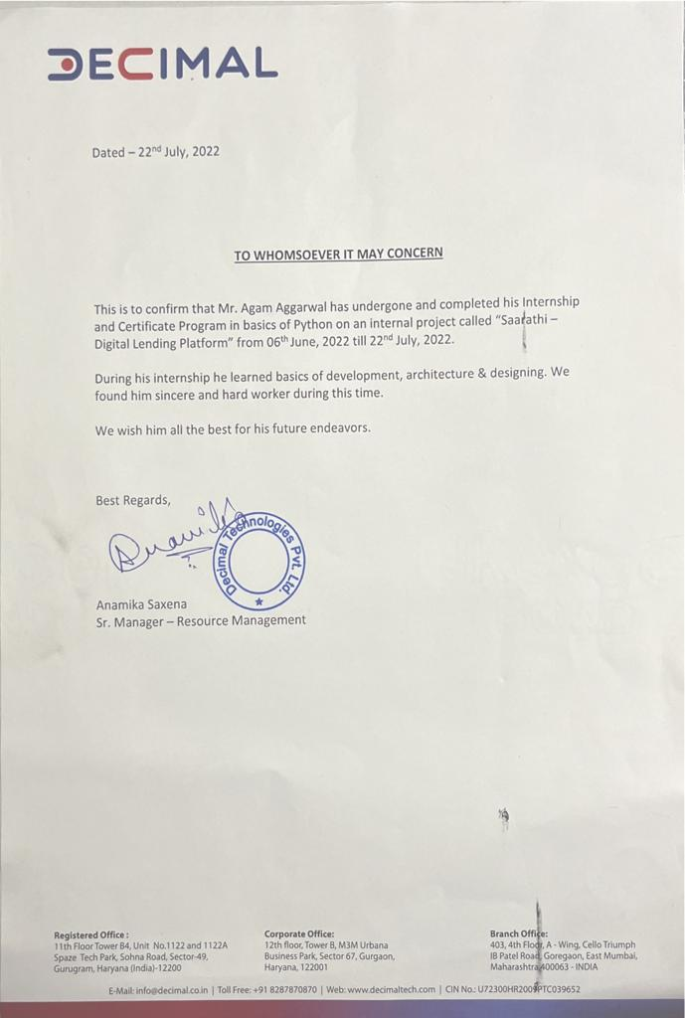
Internship Completion Certificate.

Slide 4
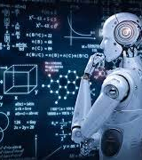
Overview
The summer internship was carried out in the Head Office of DECIMAL Technologies Pvt. Ltd. Located in Urban Square - sector 67, Gurugram Haryana. The major goal of the internship was to familiarize interns with the concept of python along with web development. It also focused on making them familiar with their Companies resource like :- SAARATHI – A digital Lending Platform.
The internship was held for 7 weeks. The first 3-4 weeks were covered with training in which we learned concepts of
python-machine learning along with web development. On that, we were asked to make a project on making a website that was held in a group of 6.
The internship was held for 7 weeks. The first 3-4 weeks were covered with training in which we learned concepts of
python-machine learning along with web development. On that, we were asked to make a project on making a website that was held in a group of 6.

Slide 5
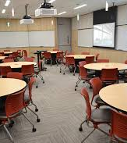
Training and INternship
The internship began on 06th June, we were given a small orientation about decimal technologies and then we coordinated with the other interns their and our seniors. After that, our training started from the very first date that was held for 3 weeks approx. In training we were taught or can say gone through with the concepts of python and web dev. the main focus was on concepts of machine leaning integrated with web development. Some things that were taught are as follows Exploratory Data Analysis(EDA) , basic python like importing and visualization of different aspects along with machine learning concepts that were to be involved in project.

Slide 6
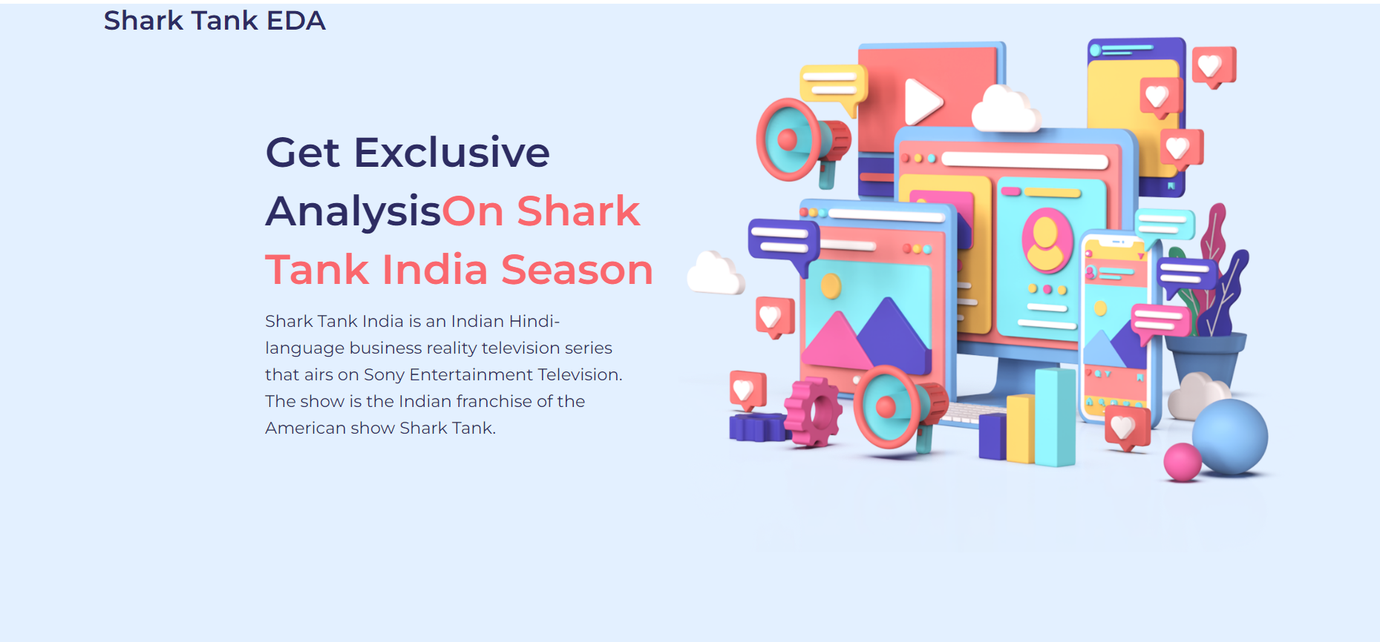
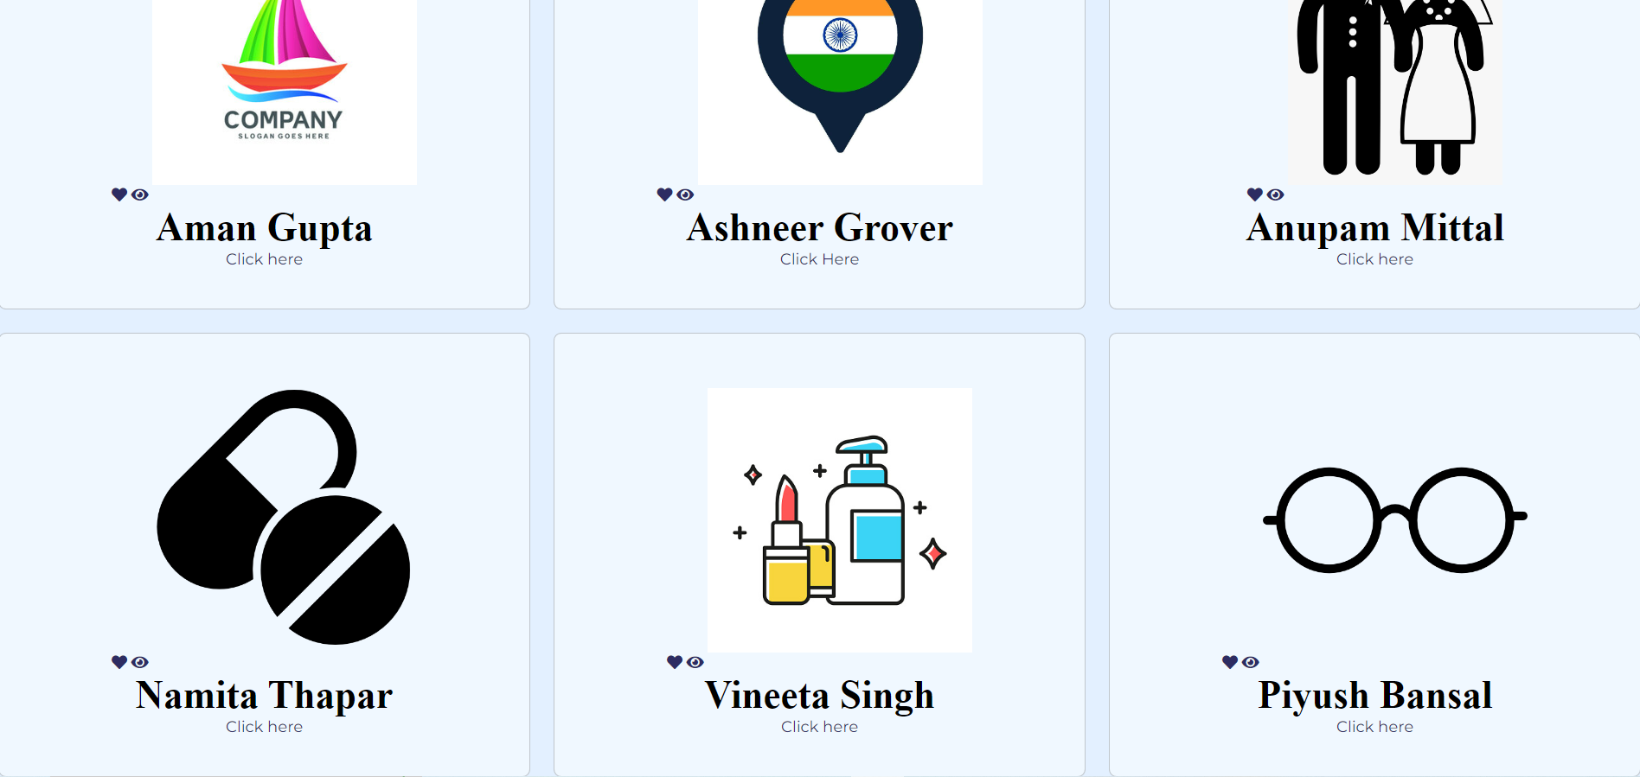
OUTPUTS -
HOME PAGE

Slide 7
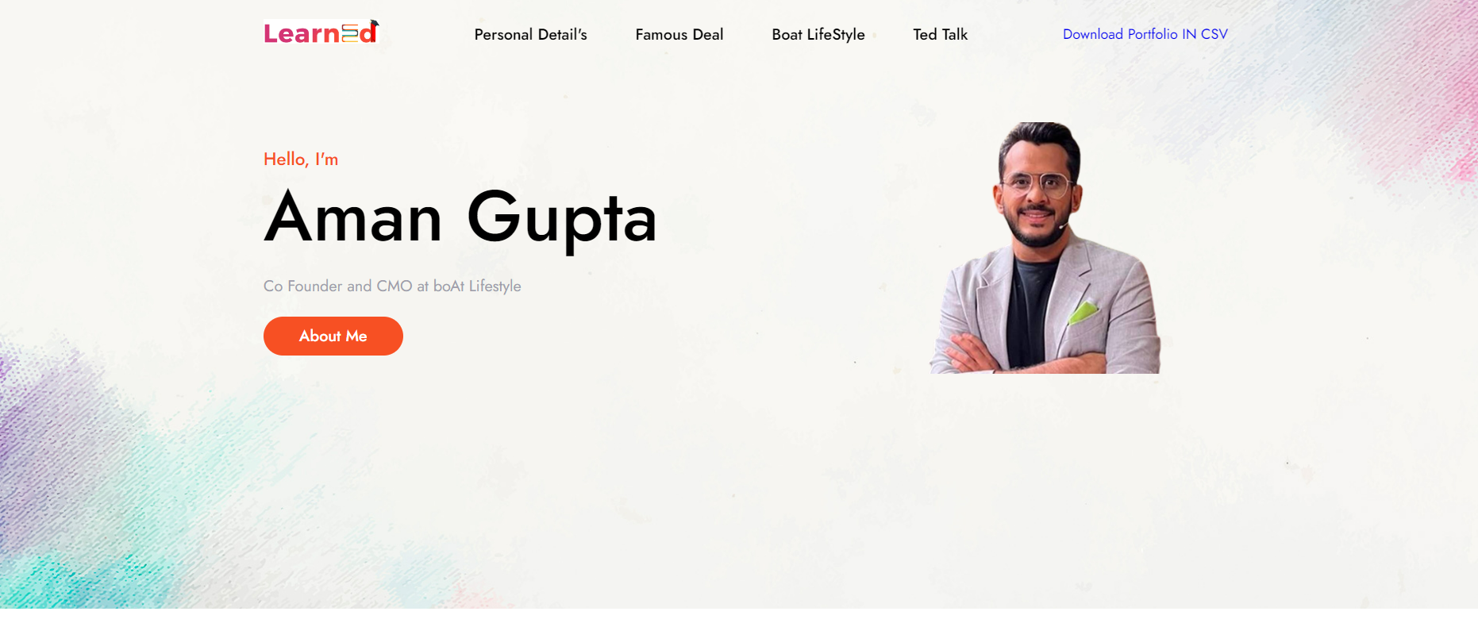
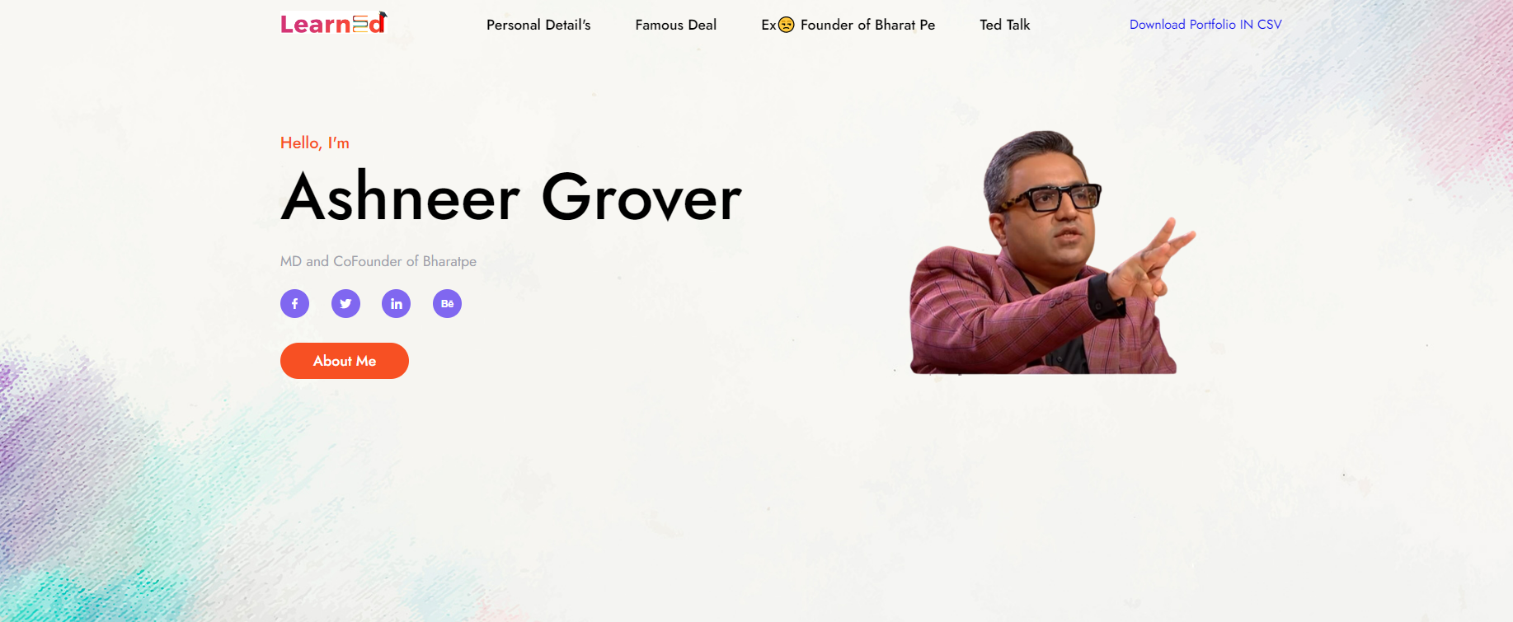
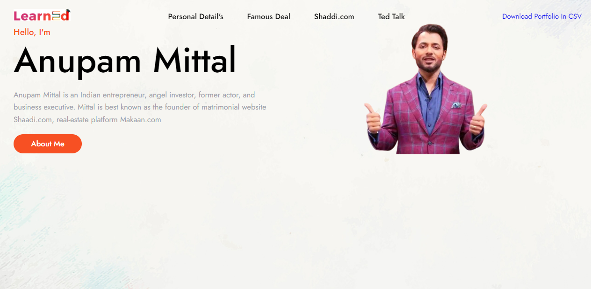
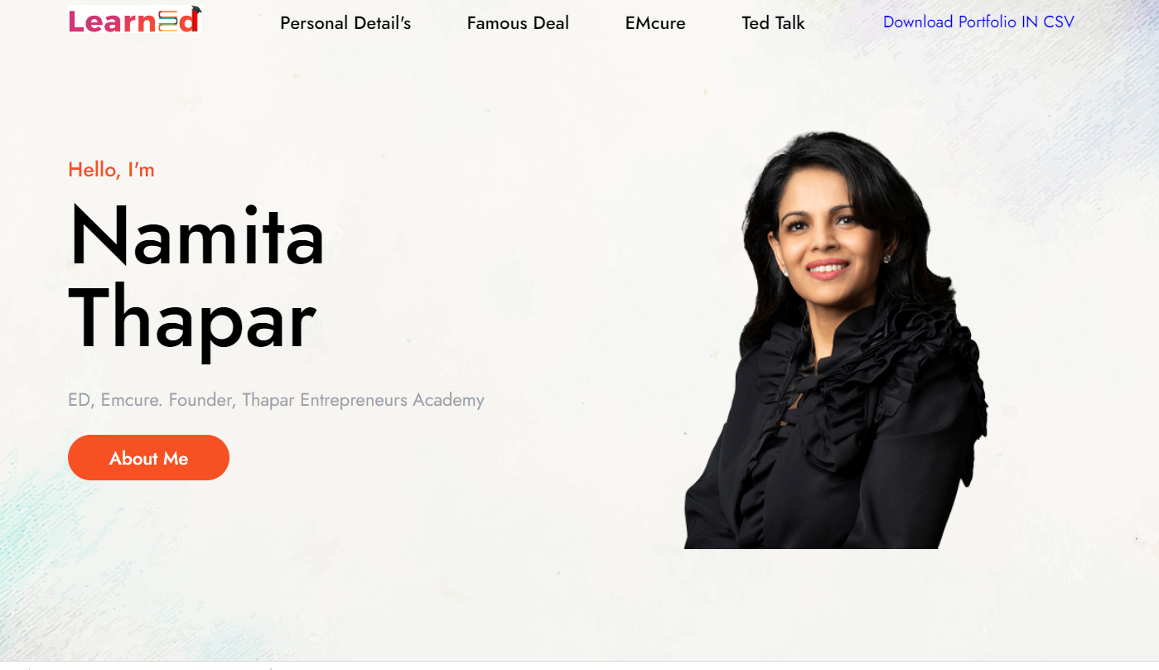
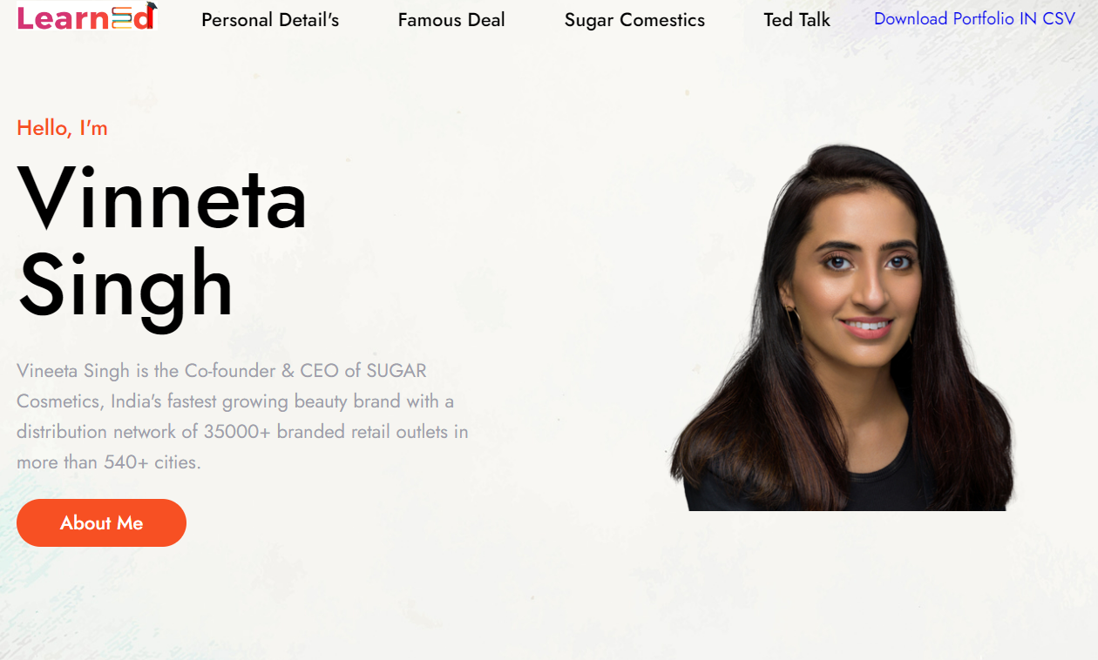
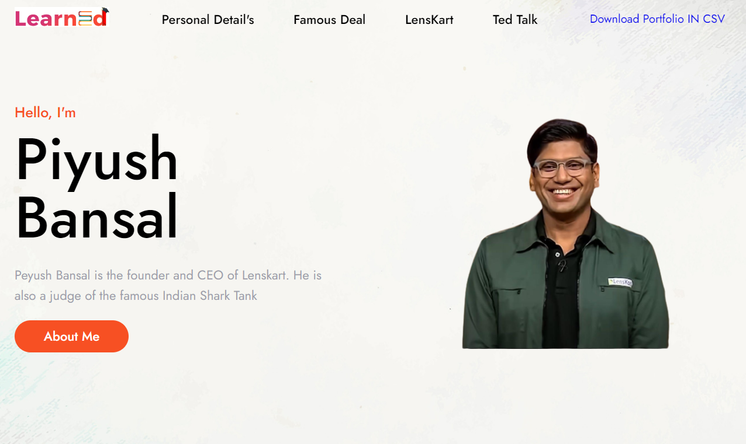

Slide 8
Methodology
This technique was used for generating the all designed things for all sharks like their revenue generated and involved , their investment amount, investment equity, the most liked company or ideas my sharks , also in which companies they have invested in. Here, we are talking about six sharks that are Ashneer Grover, Peyush Bansal, Anupam Mittal, Aman Gupta, Namita Thappar, Vineeta Singh.
In the next step we created the individual shark portfolio for the format in csv like the following- the basic idea behind creating the portfolio is the statistical showing of each shark total investment, equity investment, debt/loan amount etc. To work on this we firstly import pickle lib and our dataset. Here we used Exploratory Data Analysis(EDA) methodlogy that is an approach to analyze the data using visual techniques. It is used to discover trends, patterns, or to check assumptions with the help of statistical summary and graphical representations.
Starting with creating the index page we use web development concepts to create a home page that acts as a introductory page to our project it shows a basic intro along with description about each shark of their background, their work, total investments made , total equity loan. In this we have created 6 different logs for each shark and then combined them all together. This involved basic web development and most importantly CSS required for styling and layout of web page.
Now with the machine learning part firstly we import libraries that are important for our project execution such as pandas, matplotlib.pyplot, seaborn, sklearn etc. Then we import the dataset and print the following information such as season number, pitch number, etc. After that analyzing about the pitchers, origin of the company, industry, number of presenters(male or female) . After that we analyze the highest revenue generated brands in the show for that we import stack_effect library from opcode and groupby to make the bar graph of the revenue generated.

Slide 9
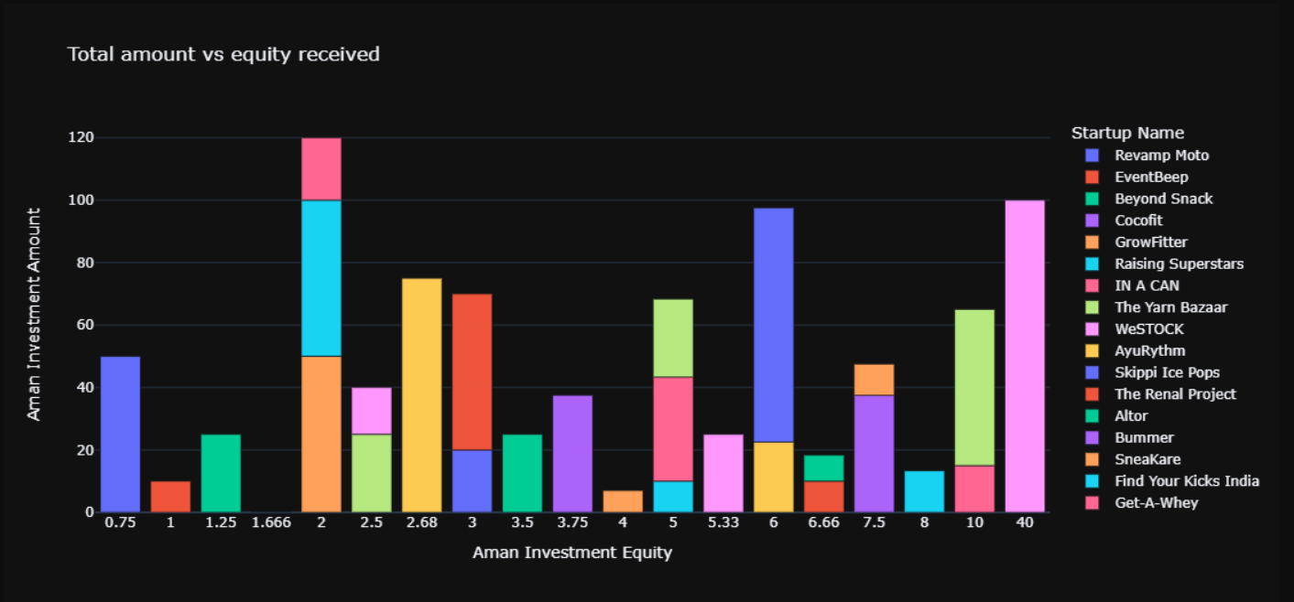
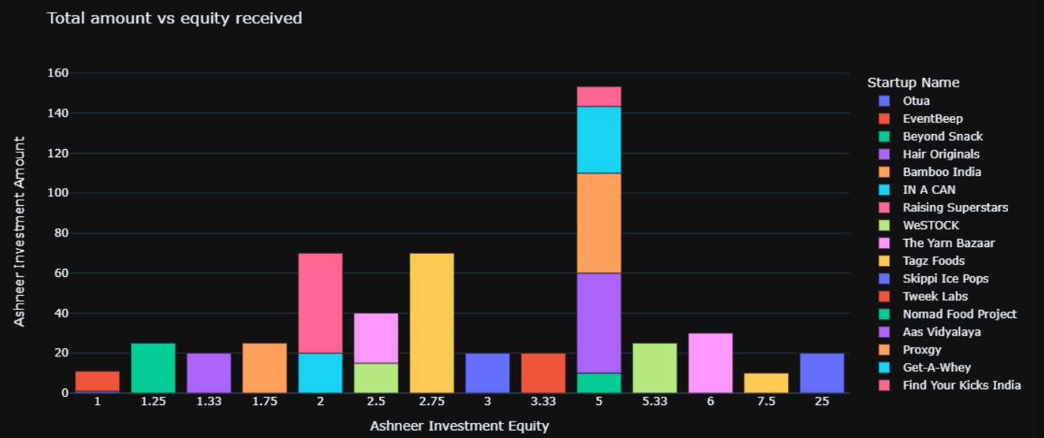
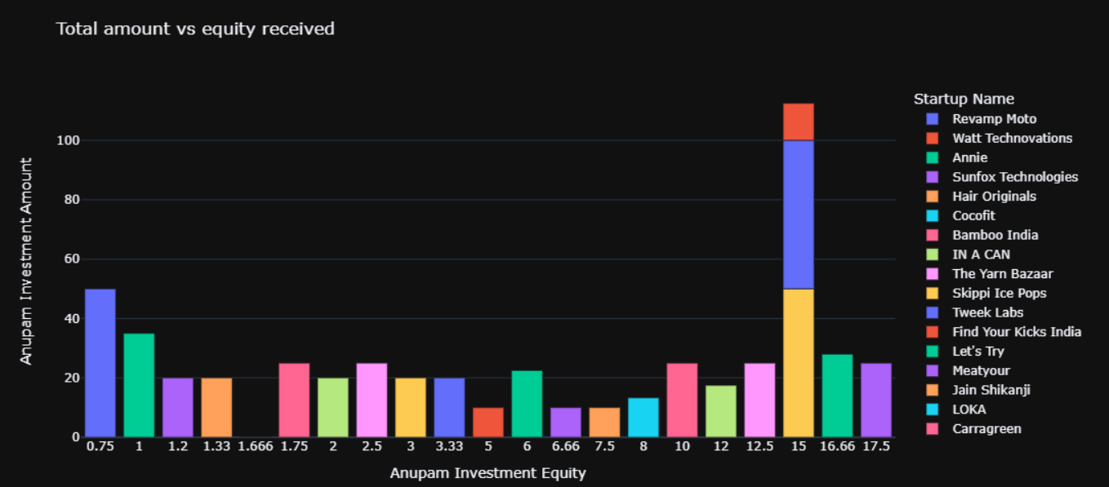
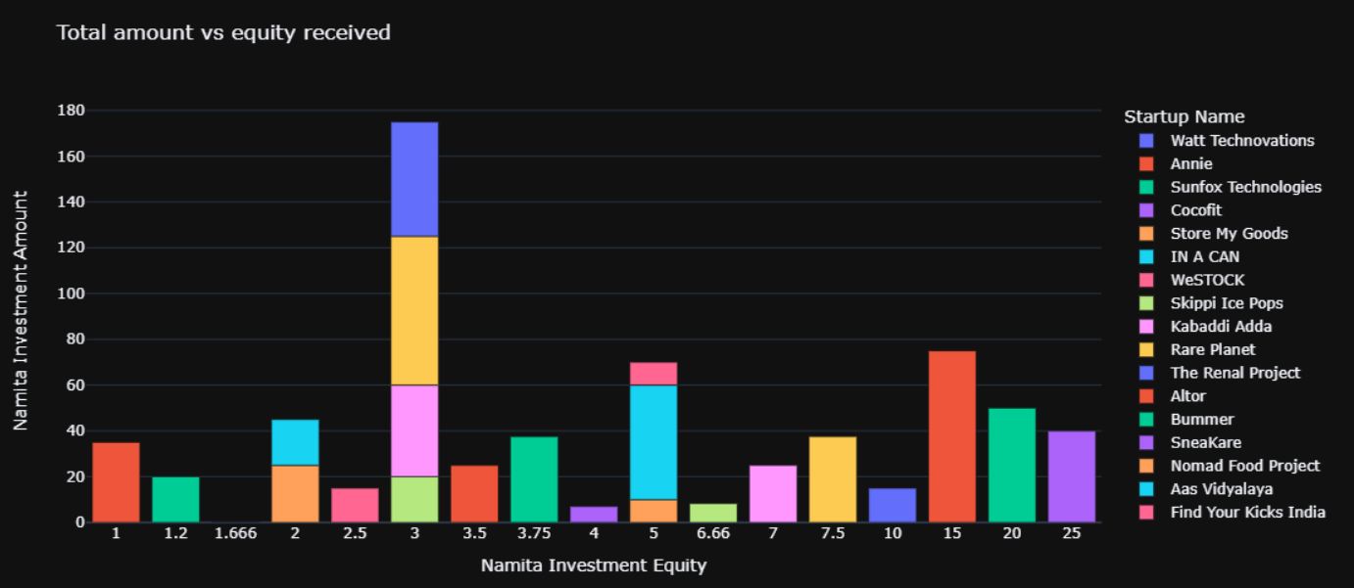
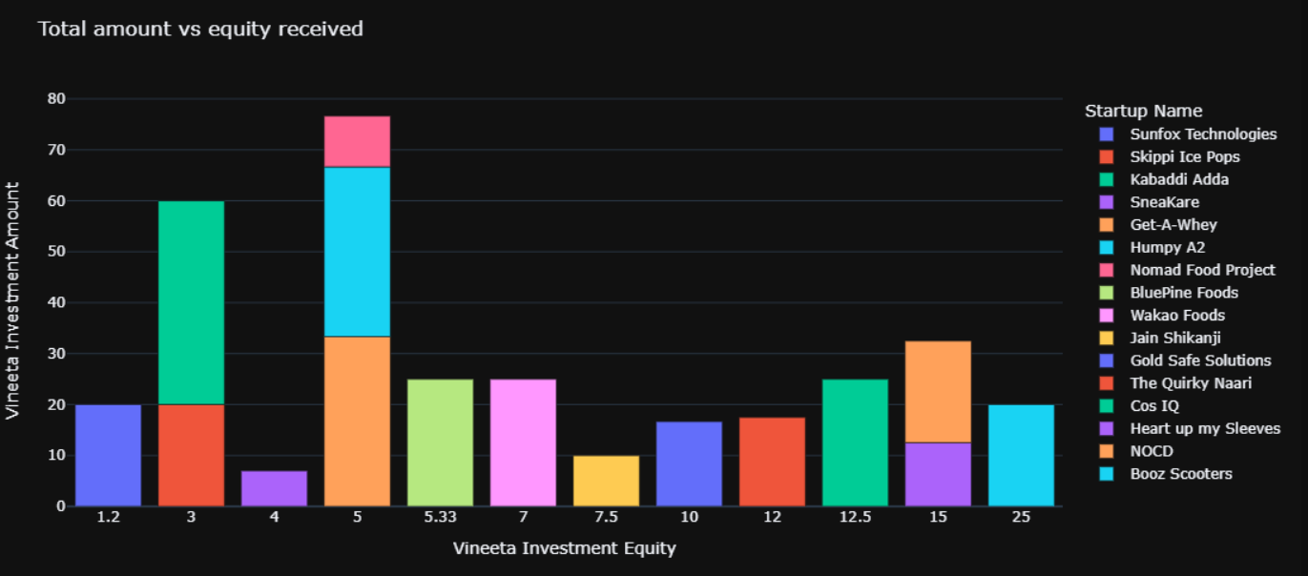
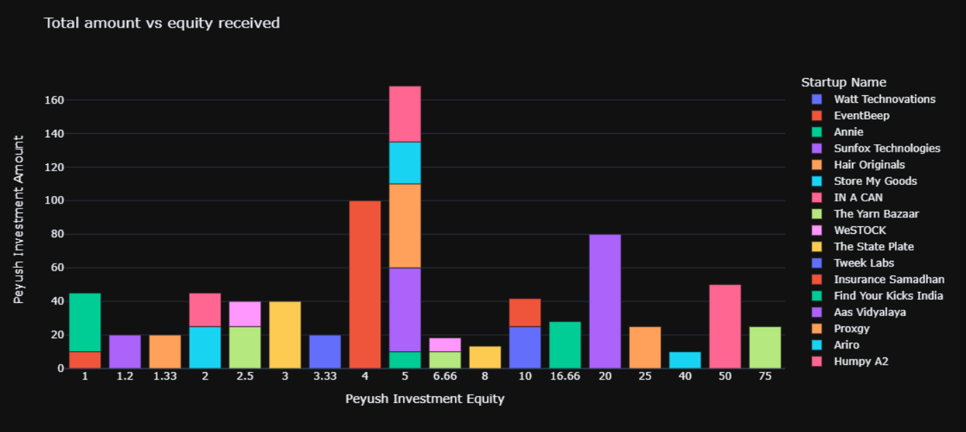

Slide 10

SAARATHI-Digital Lending Platform
Given training to the internal software of the company SAARATHI- Digital Lending platform which is a new one-of-a-kind lending marketplace, specializing in the digital transformation of loan files. The AI-based product enables hassle-free, paperless digitalization of multiple financial products such as loans, credit cards, and insurance on one platform. Saarathi offers a transparent, low-cost process to the lender ecosystem ensuring loan files are trustworthy and fraud-proof, while at the same time making the approval process 5X aster. for customers.
Here we were given basic introduction to the platform which involved of how Saarathi works, as mentioned above.
So basically Saarthi is a digital lending platform that provides multiple financial products such as loans, credit cards, and insurance on one platform.
So here we were given training about how it works the background behind it the designing behind it, the ideas for it etc. As we know that applying for such things is quite difficult but with this platform it makes a one stop destination for the work.

Slide 11
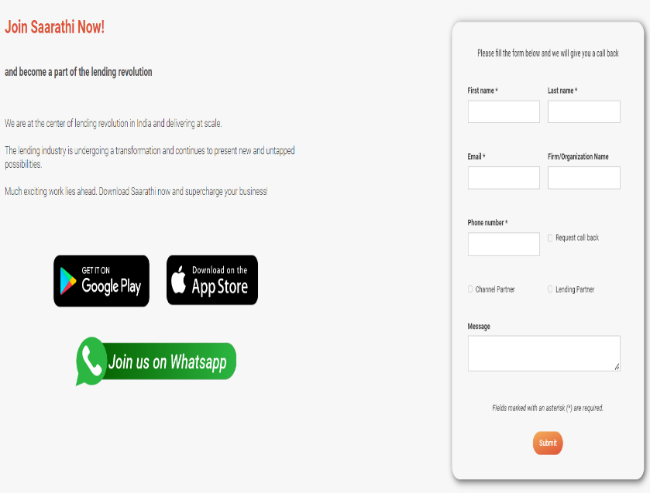
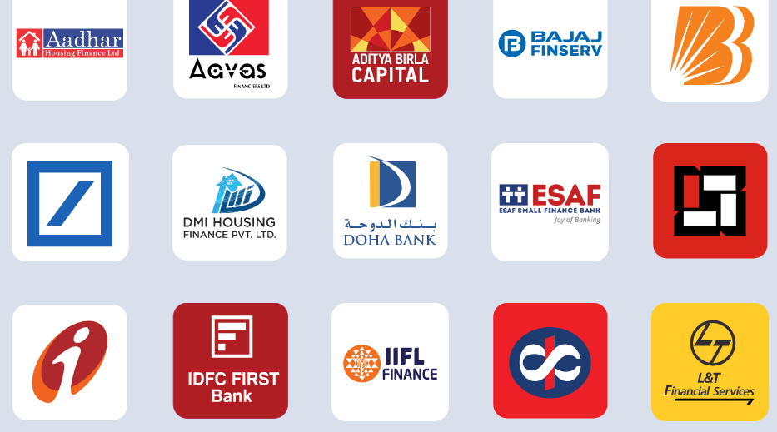
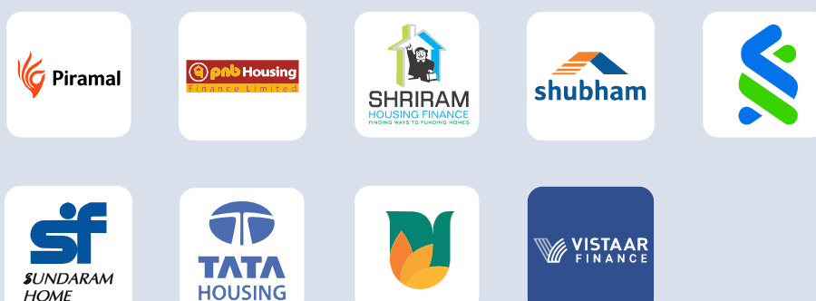
TIE-UPS and Procedure
. It has tie ups with Aadhar housing services, Aditya birla, bajaj, BoB, icici bank , HDFC, PNB and many more.
Now is a person who is willing to apply for above mentioned aspect, he/she can directly direct to the Saarathi webite (https://www.saarathi.ai/) create a profile there by signing up there and selection in which type of loan that they are try to raising as mentioned above.

Slide 12

Procedure
When this work is done the query gets registered in the database and within seconds various options come in with each and every detail of their types, how it gonna work, requirements, easiness etc.After the the customer could easily contact with the given partner of his/her choice and go through the procedure and get hassle free fulfilment of requirements. Not only this it could also be used as a single platoform to track and manage all loan applications.
The whole mission behind this is Democratize Access to Financial products by empowering financial intermediaries via technology to unlock growth through digital distribution.
The project was launched in 2020 and the final overview of the project is as follows –
Hence we can see the project came to and end on apr’22 where almost 3000cr loan files were being processed and Icorporation to Saarathi Pvt Ltd.

Slide 13
CONCLUSION
This training and internship about python and lending platform software helped me to gain the ability to understand concepts technically as well as theoretically so that can be implemented on a real time project works. This six weeks gave me the confidence in the basics of computer language coding as to increase my skill set further and get ahead in the field. The faculty taught us the correct and right amount of information that helped a lot during project making and implementing Saarathi . The benefits are many like we got certified from the Company which add more value to our cv. It shows the strong background in the technical field. Overall, the experience was good and got a lot to know and learn.

Slide 14
THANK YOU!!!

